Slide 1
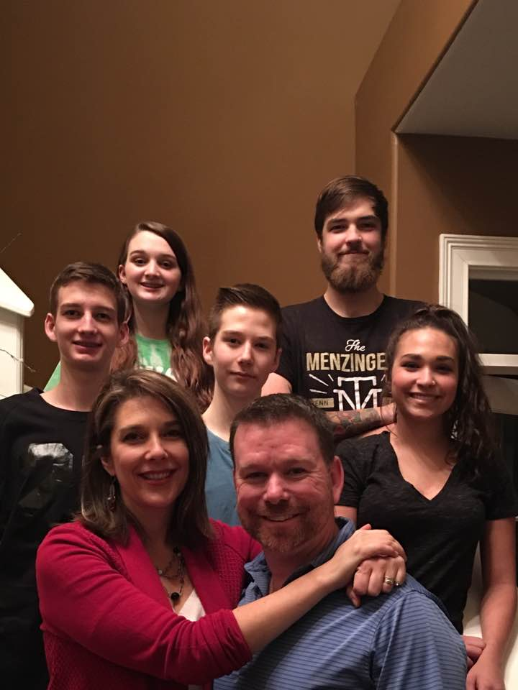

Slide 2
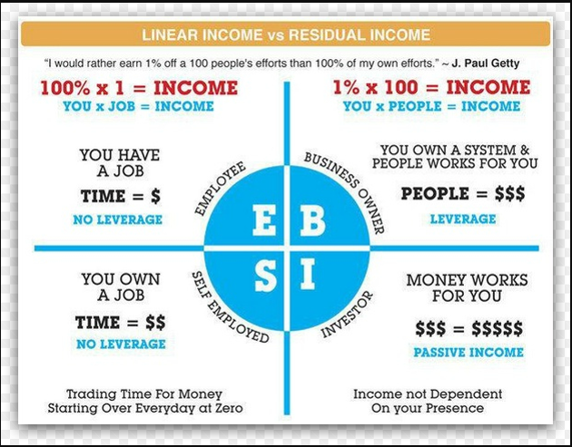

Slide 3
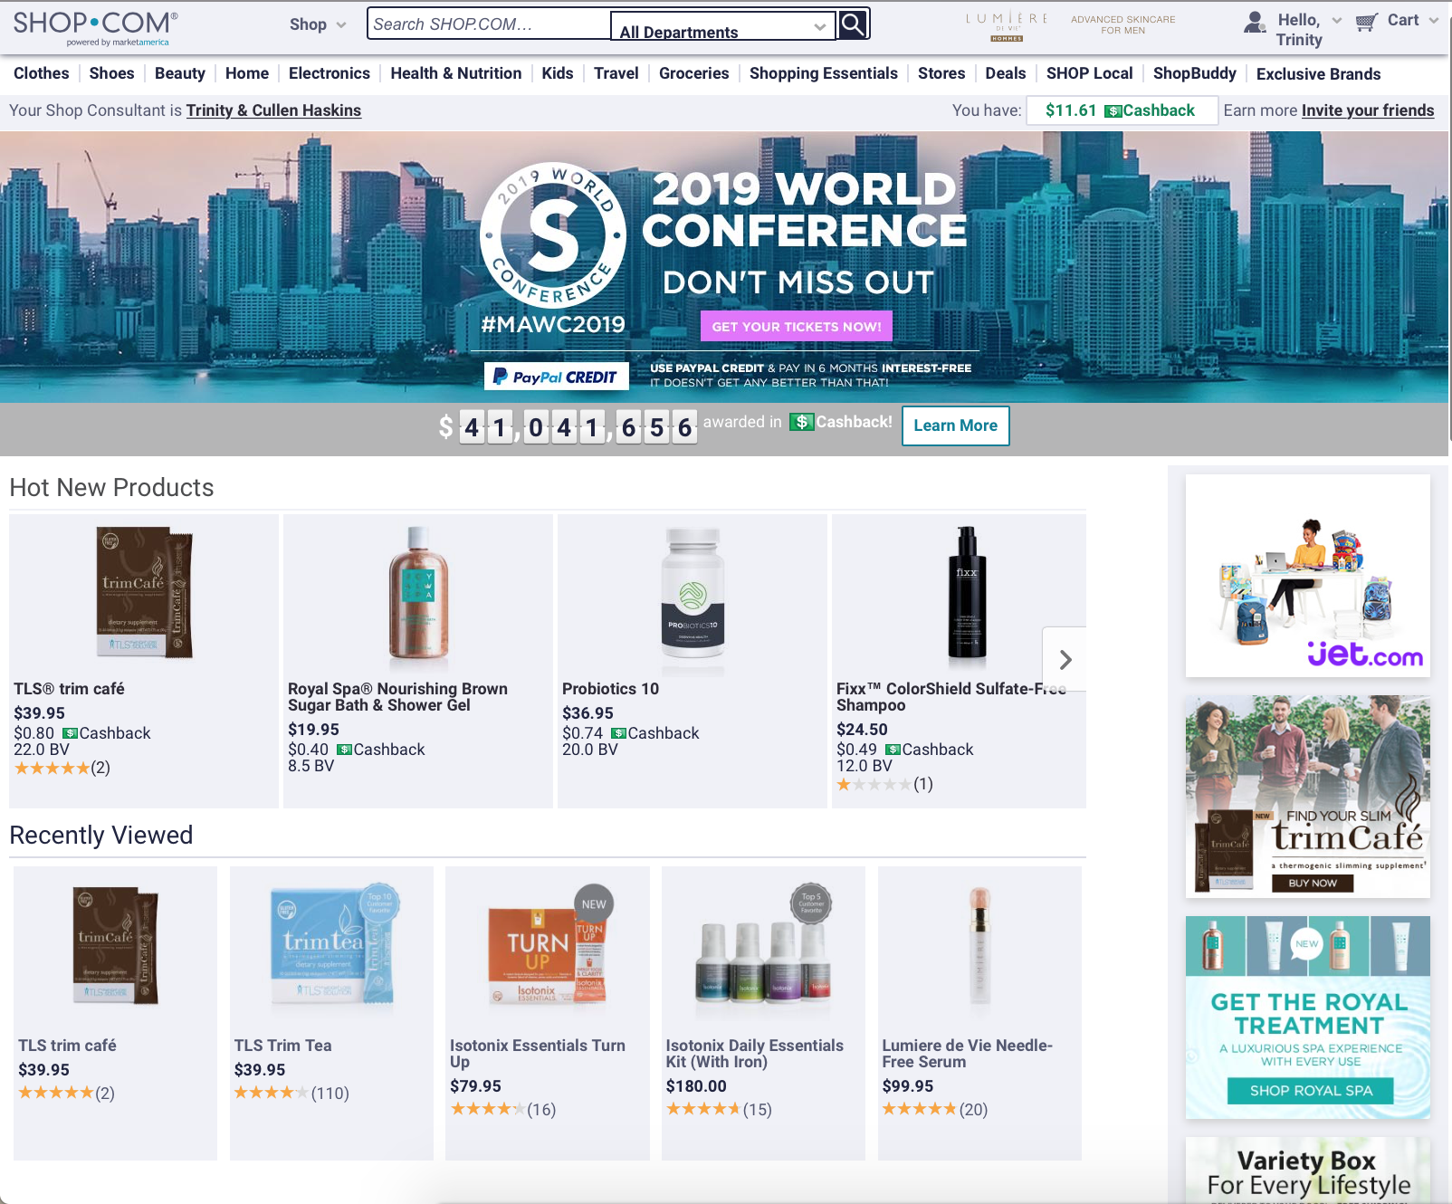
Customer
SHOP.com
/yourname
Business Owner
Save Money on Items you are buying anyways
Cash-back earned on purchases made (average 2-5%)
Find the best Prices with Shop Buddy
Recycle your household dollars
Wholesale to Retail profit
on exclusive MA brands (average 30%)
Business Volume (BV) commissions up to $2100/week
Internet Business Volume (IBV) commissions up to $1500/week
Earn $3600 a week
Convert Spending into Earning & Create Shopping Annuity
Earning $3600 a week or $187,000 a year

Slide 4













Vertical Marketing Structure
HORIZONtal Marketing Structure
ENCOURAGES TEAMWORK
ALL WORKING TOGETHER
EVERYONE RECEIVES 100% CREDIT FOR SALES AND VOLUME GENERATED
EARNING POTENTIAL IS NOT
DETERMINED BY POSITION
REAL ESTATE, INSURANCE, SALES, TRADITIONAL BUSINESS
ALL IN COMPETITION

Slide 5
You can make a little money or make a lot of money doing what you are already doing.
Become a Business Owner.
Become your own best customer
Create a handful of customers

